Slide 1
EECE 71030 – Winter 2024
Week 4 – Vigenère Cipher

Slide 2
Secure Programs
Faults and Failures
Malicious Code
Non-Malicious Code

Slide 3
Fault vs Failure
Fault: Discrepancy in code that causes a failure.
Failure: External behavior is incorrect
You can fix a fault by “Patching” it.
https://softwaretestingtimes.com/2010/04/fault-error-failure.html

Slide 4
Malicious vs Non-Malicious
Malicious Code is embedded in the code designed to cause failures
Non-Malicious code are generally behavior / capabilities in the system meant as a feature but can be utilized by an attacker to cause a failure.
Cause Unintentional Security Flaws e.g. The Heartbleed Bug

Slide 5
Malicious Types
Virus: A virus is a type of malicious software that attaches itself to legitimate programs or files and spreads when those files are executed.
Worms: Worms are self-replicating malicious programs that can spread across computer networks.
Trojan: A Trojan, short for Trojan Horse, is a deceptive piece of software that appears harmless but contains malicious code.
Logic Bombs: Logic bombs are pieces of code intentionally inserted into a program or system that remain dormant until a specific condition or trigger event occurs.

Slide 6
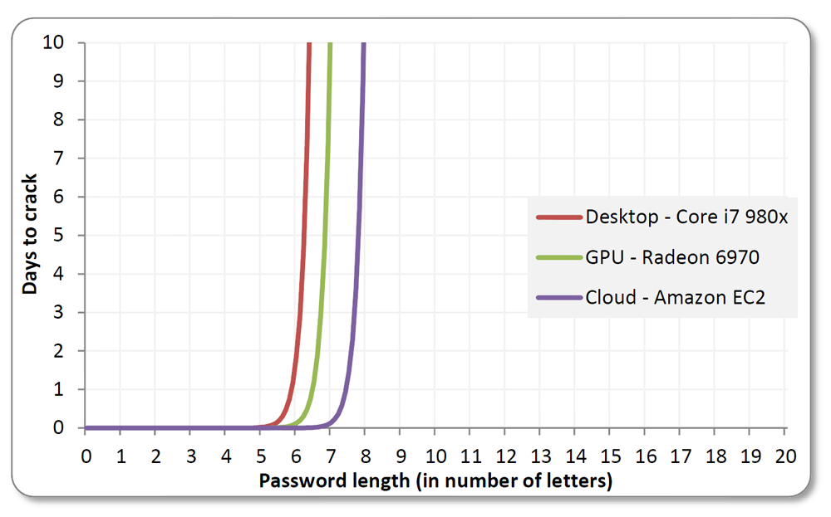
Brute-forcing passwords
https://blog.erratasec.com/2012/08/common-misconceptions-of-password.html

Slide 7
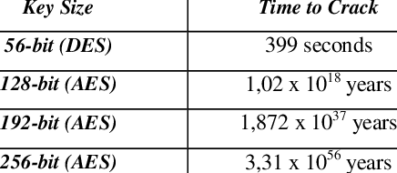
Cracking the code
Reference: Memos, Vasileios & Psannis, Kostas. (2015). Encryption algorithm for efficient transmission of
HEVC media. Journal of Real-Time Image Processing. 12. 10.1007/s11554-015-0509-3.

Slide 8
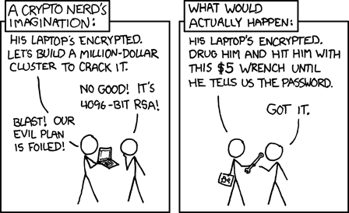
Cracking the code
Reference: https://xkcd.com/538/

Slide 9
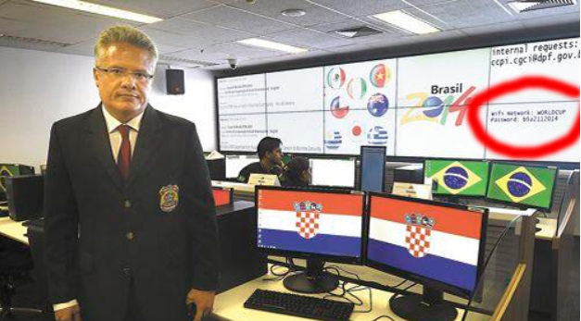
Cracking the code
Reference: https://www.theregister.com/2014/06/25/brace_yourselves_brazil_dill_in_world_cup_wifi_spill/

Slide 10
Similar Algorithms
Similar “Substitution Ciphers”:
Atbash Cipher
One-Time Pad
Vigenère Cipher
Hill Cipher

Slide 11
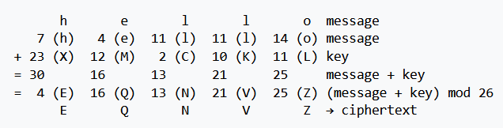
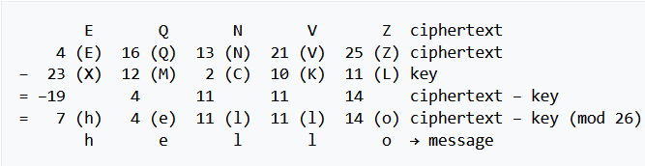
Perfect secret-key encryption
One-Time Pad, is an encryption technique that cannot be cracked
The key is as long as the plaintext
The key is random
The key must never be reused
The key is kept completely secret
Reference: https://en.wikipedia.org/wiki/One-time_pad

Slide 12
Vigenère Cipher
Named after Blaise de Vigenère, a French diplomat in the 16th century
It is a classic substitution type encryption technique
It is a polyalphabetic substitution cipher:
uses a keyword for encryption / decryption

Slide 13
Vigenère Cipher
Select a confidential keyword.
Align the keyword with the message and repeat as needed.
Encryption (For each letter)
Find corresponding keyword letter.
Calculate shift based on keyword.
Shift plaintext letter for encryption.
Decryption (For each letter)
Identify keyword letter.
Calculate reverse shift.
Decrypt to get original letter.

Slide 14
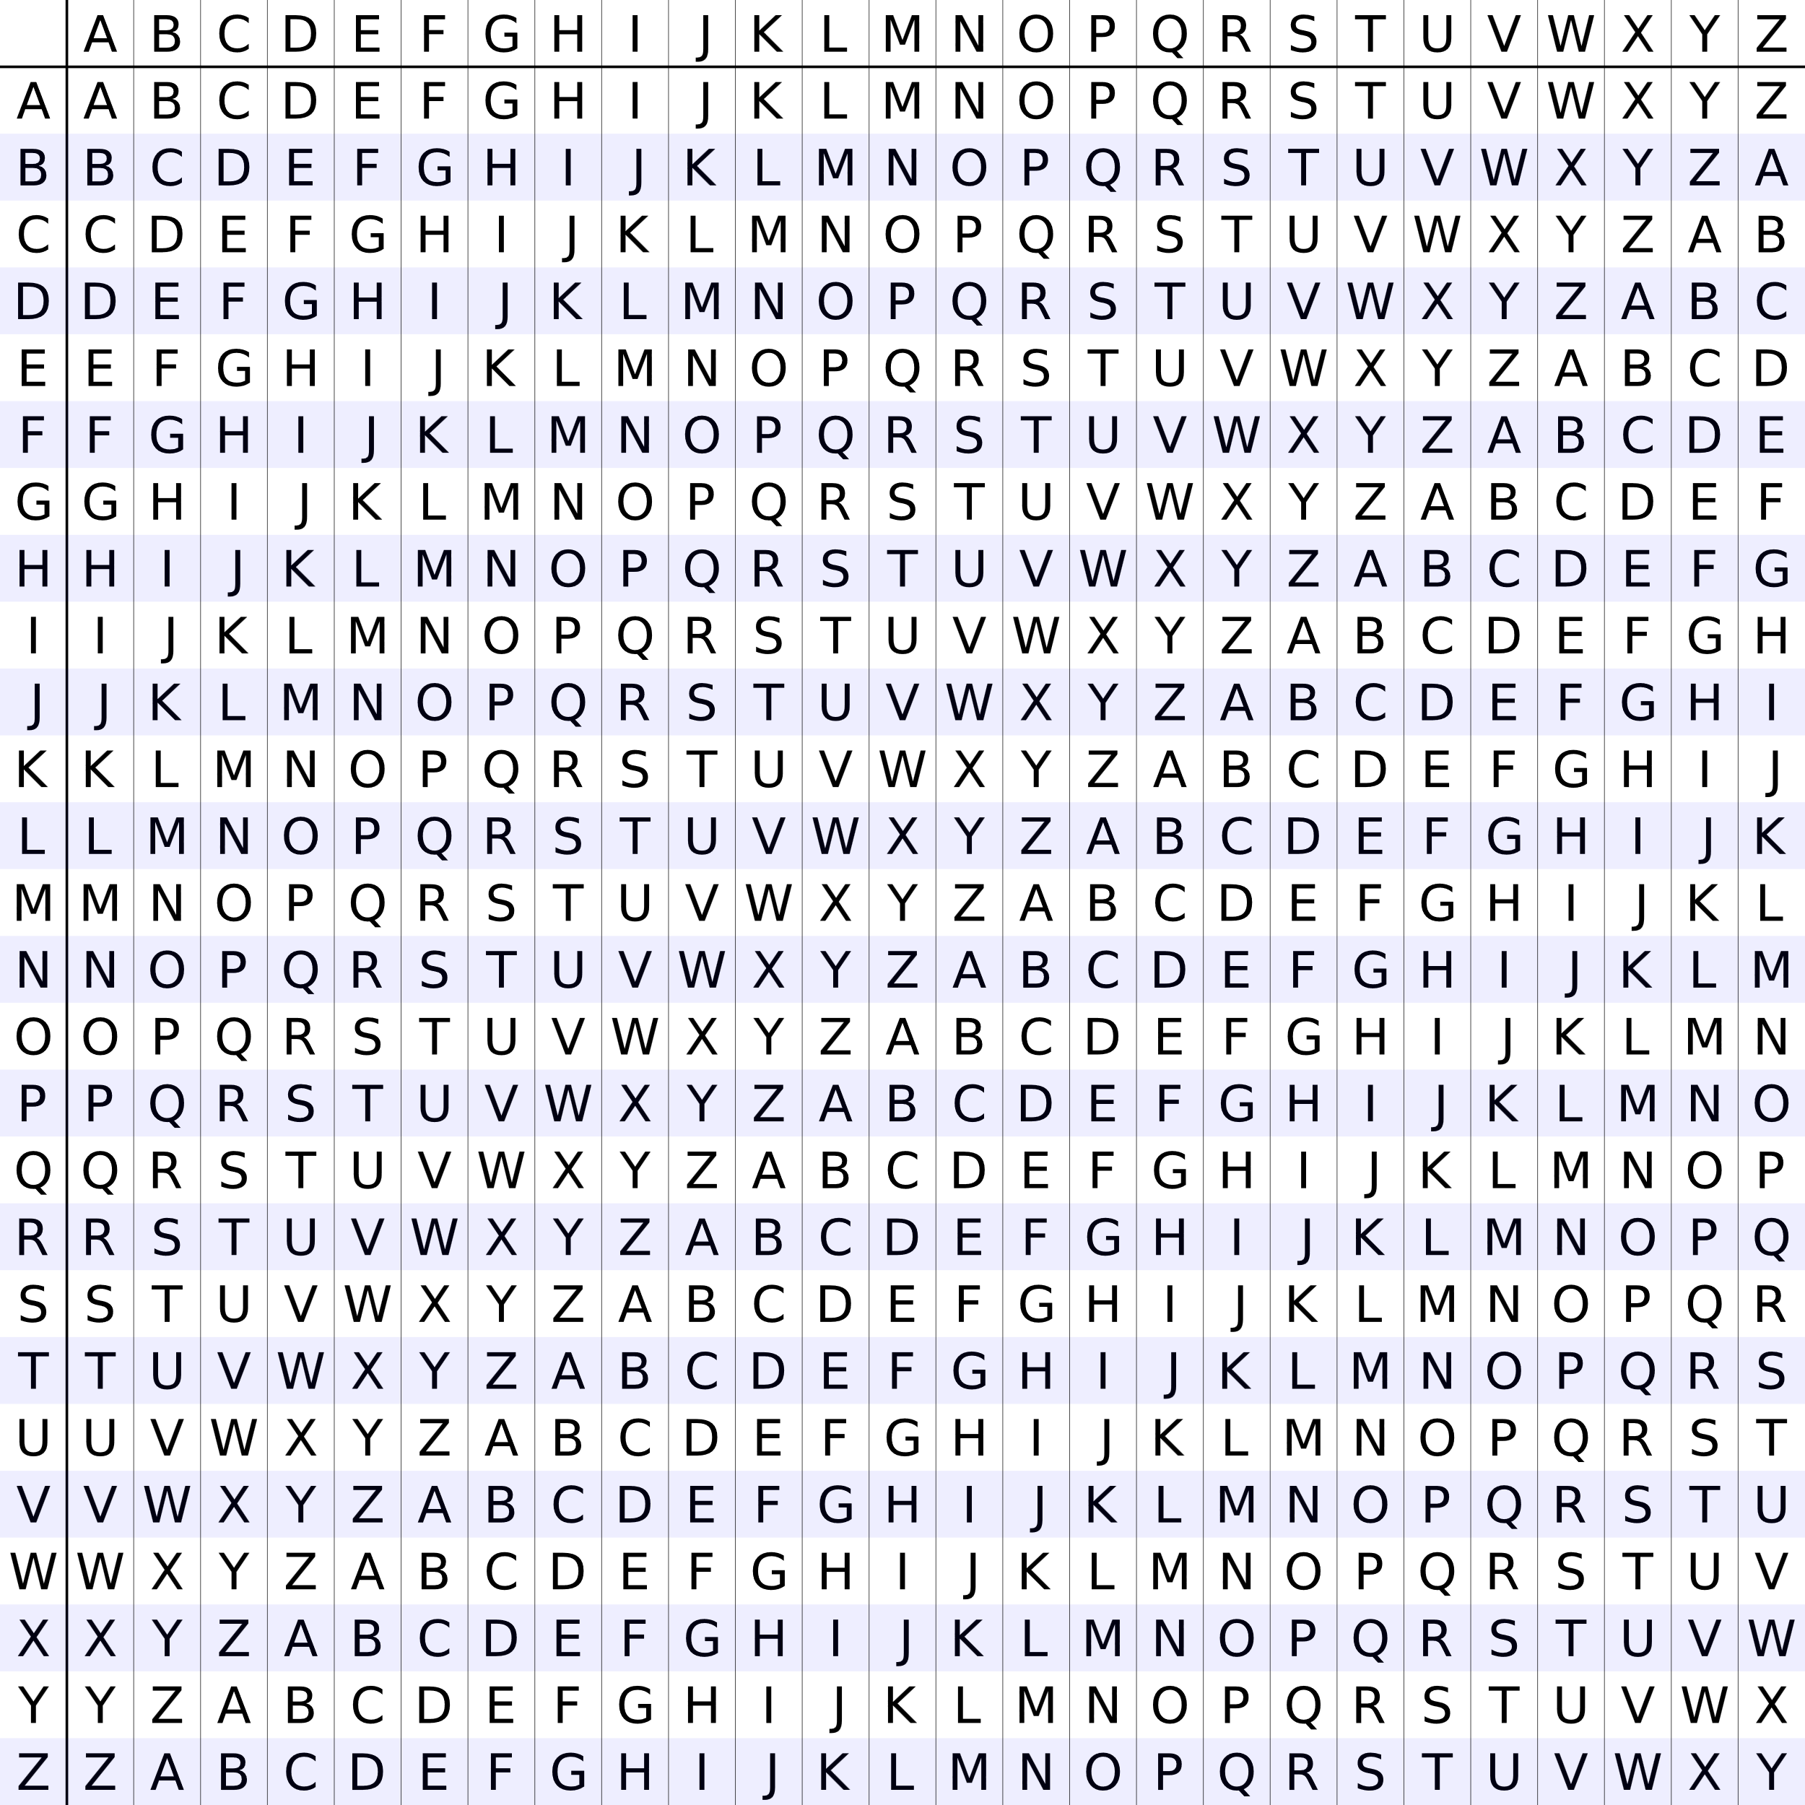
Vigenère Cipher
Reference

Slide 15
Vigenère Cipher
Plaintext | Key | Ciphertext
H | K | R
E | E | I
L | Y | J
L | K | V
O | E | S
W | Y | U
O | K | C
R | E | V
L | Y | J
D | K | N

